Slide 1
Ball Balancing Using a Robotic Arm (Simulation)
Course: Robot Programming

Slide 2
Project Overview & Team
Ball Balancing Using a Robotic Arm (Simulation)
Simulator: MuJoCo
Team Members:
Nagham Sleman – Simulation & Modeling
Hazem Afif – Control & Evaluation

Slide 3
Problem Statement & Goal
Problem Statement
Ball-on-plate systems are unstable
Small disturbances cause the ball to roll away
Continuous feedback control is required
Project Goal
Model a robotic arm that balances a ball on a plate
Implement the system in MuJoCo
Analyze system behavior and control performance

Slide 4
System & Solution Description
System Description
Two-link robotic arm with hinge joints
Plate rigidly attached to the end-effector
Ball modeled as a free rigid body
Tools & Methods
MuJoCo physics engine
XML for system modeling
Python for simulation and control
PID controller for stabilization

Slide 5
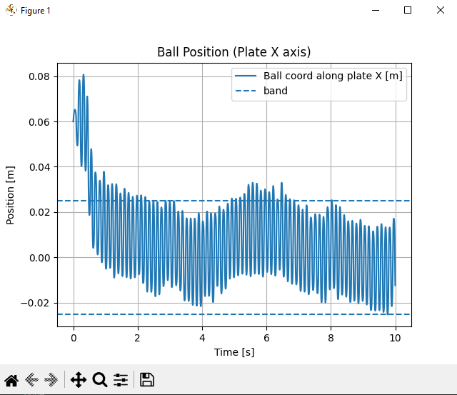
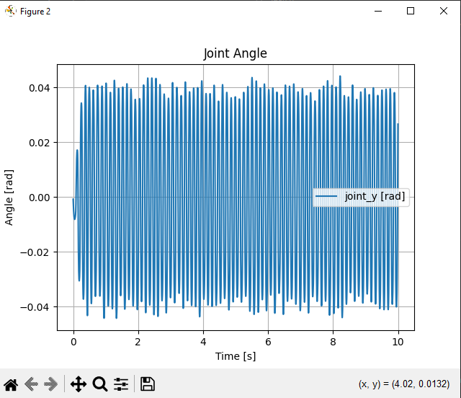
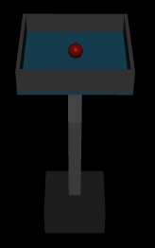
Experiments & Results
Experiments
Open-loop plate tilting
Ball motion observation
Closed-loop PID control
Results
Ball responds correctly to plate tilting
PID control stabilizes ball position
System behaves realistically and stably

Slide 6
Personal Contribution & Conclusion
Personal Contribution
Nagham Sleman
Designed MuJoCo XML model
Configured joints, actuators, and physical parameters
Implemented Python simulation and visualization
Performed open-loop experiments
Hazem Afif
Designed PID controller
Tuned control parameters
Evaluated system performance
Conclusion
Successful simulation and control implementation
Clear demonstration of ball balancing dynamics
Future work: advanced controllers and vision feedback

Slide 7
Thanks For Listening

